Slide 1
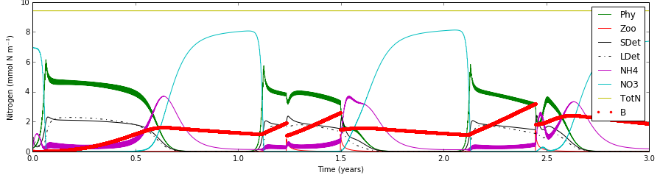

Slide 2
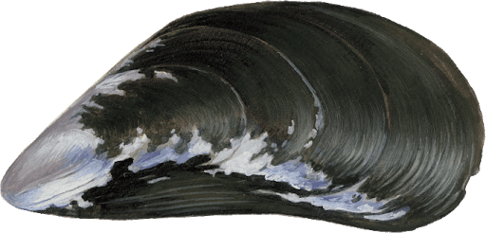

Slide 3



1 m
1 m
1 m

Slide 4
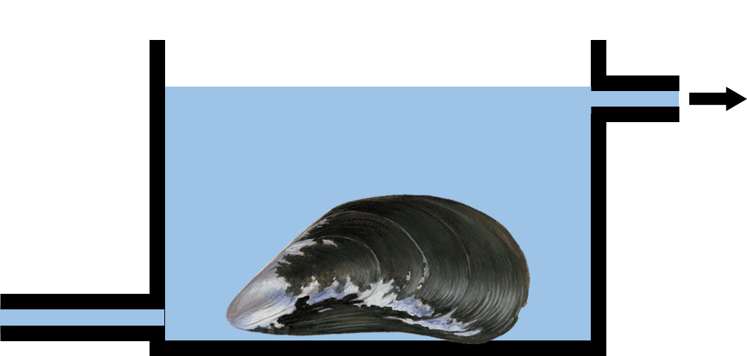
1 m
1 m
1 m

Slide 5
1 m
1 m
1 m

